Slide 1


Statistic
Lecture 5
Dr. Nada Abdullah Rasheed
Assist prof. / Computer Science

Slide 2
Syllabus Content
Subject | Lec. No.
The Mean | 3
Variability | 5

Slide 3
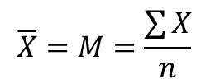
Measures of Central Tendency
3.3 The Mean
You have probably seen the symbol Σ (Greek sigma), which in mathematics is the summation operator and means to add all values to the right of Σ.
The mean is the arithmetic average of all the scores in a distribution. The mean is the most-often used measure of central tendency, because it evenly balances a distribution, so both the large and small values are equally represented by the mean and also takes into account all individual values.
$$\overline{X}=M=\frac{\sum{X}}{n}$$

Slide 4
Measures of Central Tendency
For example, we calculate the mean of the sample of n = 11 scores from the median example in Section 4.4. The scores in that set of data were:
2 2 3 4 5 6 7 7 9 10 10
To calculate the mean, determine the sum of the values (ΣX = 65). Next, divide that value by the total number of scores in the distribution (n = 11). Thus:
M = (65)/11 = 5.909
This value (M = 5.909) is close to the median value (Md = 6).

Slide 5
Variability
Variability is the differences between items, which is the second main important topic in statistics; central tendency being the other. If the central tendency (mean, median, mode) estimate where a distribution falls, variability measures the dispersion and the similarity among scores in a distribution. Measures of variability include the range, the variance, and the standard deviation.
4.1 Range:
The range is the largest value minus the smallest value, A large range indicates a large spread of scores compared to a small range.
Set I: | 2 | 2 | 2 | 4 | 5 | 5 | 6 | 6 | 8 | 10 | ∑X = 50 | M = 5
Set II: | 4 | 4 | 5 | 5 | 5 | 5 | 5 | 5 | 6 | 6 | ∑X = 50 | M = 5

Slide 6
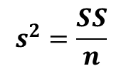
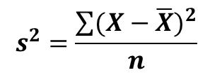
Variability
4.2 Variance (s2):
Variance (s2) is defined as the average sum of the squared deviation scores from a mean, or samply the average sum of squares and measures the average variability among scores in a distribution. Thus, variance measures by how much scores in a distribution differ on average. The formula for sample variance is:
$$s^{2}=\frac{\sum{{(X−\overline{X})}^{2}}}{n}$$
$$s^{2}=\frac{SS}{n}$$

Slide 7
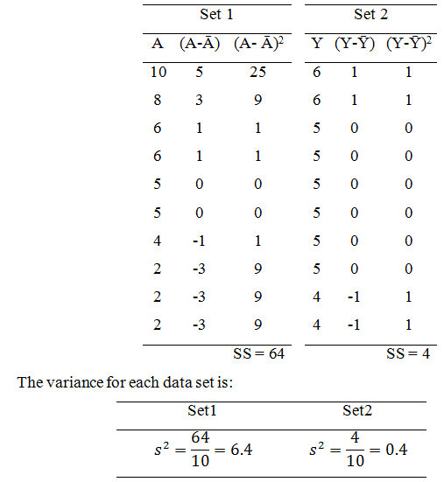
Variability
The sum of squares (SS) is defined as the sum of the squared deviation scores from the mean and measures the summed (total) variation in a set of data. Let us have, Set 1: SS = 64, n = 10; and Set 2: SS = 4, n = 10.

Slide 8
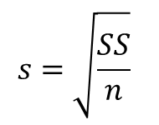
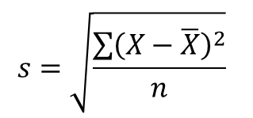
Variability
4.2 Sample Standard Deviation (s):
Once the sample variance has been calculated, calculating the sample standard deviation (s) is as simple as taking the square root of the variance.
$$s=\sqrt{\frac{\sum{{\left(X−\overline{X}\right)}^{2}}}{n}}$$
$$s=\sqrt{\frac{SS}{n}}$$

Slide 9
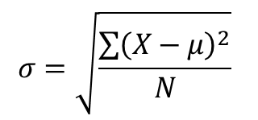
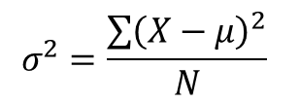
Variability
4.3 The Population Formulas for Variability
Calculating sum of squares in a population is no different than calculating the sample sum of squares, the only thing that differs is the symbols. The formula for the sum of squares in a population is:
SS=(X-μ)²
$$σ^{2}=\frac{\sum{{\left(X−μ\right)}^{2}}}{N}$$
$$σ=\sqrt{\frac{\sum{{\left(X−μ\right)}^{2}}}{N}}$$

Slide 10
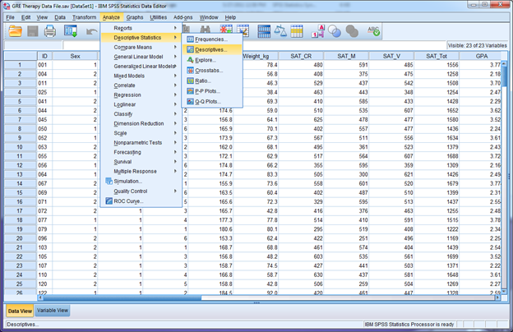
Variability
The important point is the concepts sum of squares (total variability), variance (average variability) variance), and standard deviation (average difference between a score and the mean) does not change when you are working with a sample or population (the same is true for measures of central tendency).
4.5 Central Tendency and variability in SPSS.

Slide 11
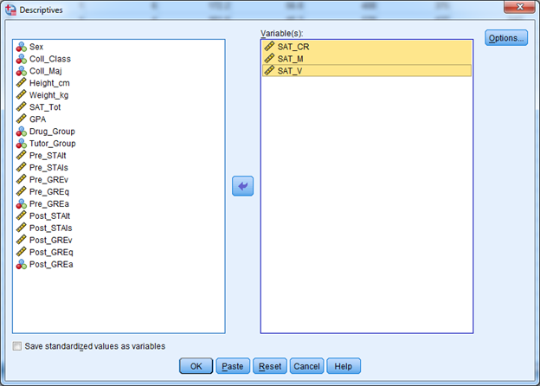
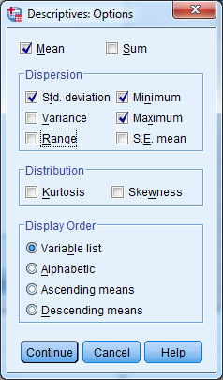
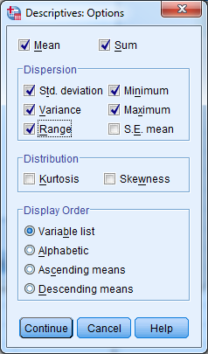
Variability

Slide 12
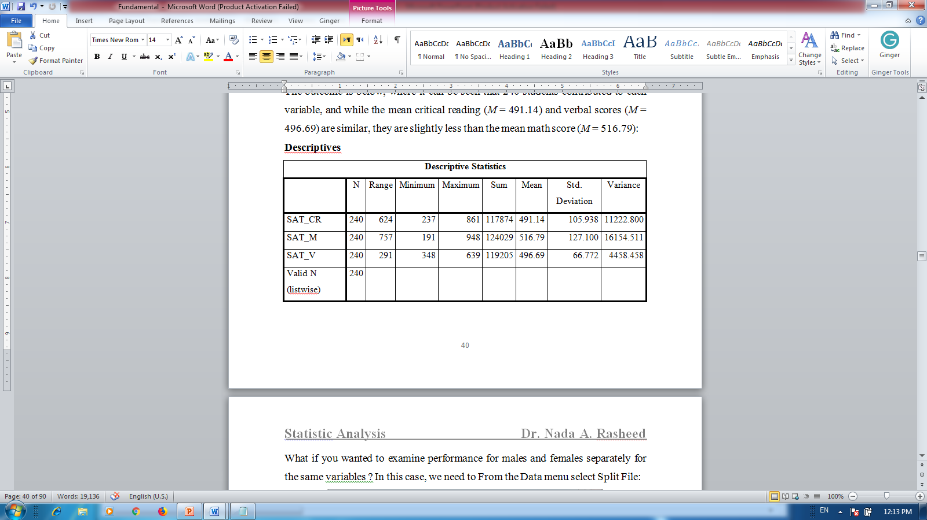
Variability
Descriptive

